Slide 2

We Live in a Mobile World
75% of the European and U.S. workforces will be mobile by 2020
97% say anytime, anywhere access to data and applications makes employees more effective
Everyone needs to be connected
Notes:
We live in a mobile world.
We all want to be connected.
--4.8 billion global mobile users in 2015 (according to Cisco Visual Networking Index 2015)
--97% say anytime, anywhere access to data and applications makes employees more effective (According to a March 2014 study of 300 SMB IT pros by Dimensional Research)
--Super-sized screens lead to super-sized data plans. For example, iPhone 6 Plus generates 2 times the data of iPhone 6, and 10x the data than 3GS (According to a March 2014 study of 300 SMB IT pros by Dimensional Research)
(More data:
--by 2020, global mobile IP traffic will reach an annual run rate of 367 exabytes, up from 44 exabytes in 2015
http://www.cisco.com/c/en/us/solutions/collateral/service-provider/visual-networking-index-vni/mobile-white-paper-c11-520862.html)
Whether traveling or around town, work or personal, we are all mobile. We are all on the go. We all want to access the information we want – when we want it.
For business in particular, we want our teams to be connected wherever they are. We don’t want to sacrifice productivity, because employees can’t connect. We don’t want to sacrifice security, for the convenience of free Wi-Fi. We need greater bandwidth for Cloud-based apps, video streaming, and sharing large files. We want to know how much we are spending on connectivity, and we don’t want to get hit with unforeseen charges.
(Open up the discussion; share anecdote about another customer in the same industry as your prospect)
We work with other companies in the [insert industry of prospect] space. For example, [insert competitor/peer] tells us that their need for mobility is so great, they are creating a whole mobility strategy to keep their employees connected when they are outside of the office. They are focused on issues such as [insert issues]. Are these issues you are focused on? Can you tell me what you are thinking about in terms of your mobility strategy?

Slide 3

The World is Going Wi-Fi First
People are choosing Wi-Fi over 3G/4G
Smartphone users spend more than 50% of their time using Wi-Fi
Wi-Fi is faster and cheaper than cellular
Wi-Fi offers better experience for high-bandwidth applications
Wi-Fi is available in places where cellular is not
“Wi-Fi first technology will be great for consumers, disruptive for mobile firms.”
—The Economist
Notes:
Research has found high levels of mobile Wi-Fi connections both in countries where mobile broadband is ubiquitous as well as in countries where mobile data infrastructure is more limited. In fact, in many places, Wi-Fi has become a far more important mobile data technology than 3G or 4G. The most mobile-Wi-Fi-hungry country in the world was the Netherlands, where Wi-Fi accounted for 70% of all of the smartphone connections we measured. In the U.S., two-thirds of U.S. consumers prefer Wi-Fi over cellular, aligning Wi-Fi stats in the U.S. with those across the rest of the industrialized world. (http://www.fiercewireless.com/wireless/deloitte-two-thirds-u-s-consumers-prefer-wi-fi-over-cellular)
There is a huge trend towards massive adoption of Wi-Fi around the world, propelled by several factors:
-According to research, Wi-Fi will carry up to 60 percent of mobile data traffic by 2019. (http://www.juniperresearch.com/press/press-releases/wifi-to-carry-60pc-of-mobile-data-traffic-by-2019)
-The increasing availability of Wi-Fi—and its ability to piggyback on existing fixed-broadband networks—makes a Wi-Fi first model a viable, lower-cost alternative to traditional cellular plans.
-Users prefer Wi-Fi over cellular for performance on applications and ease of use. (http://www.computerworld.com/article/2506011/wireless-networking/mobile-users-prefer-wi-fi-over-cellular-for-lower-cost--speed--reliability.html)
-Wi-Fi is also important for retailers, both brick and mortar retailers who offer amenity Wi-Fi to shoppers and online retailers who rely on consumers connecting to Wi-Fi to access retail applications. In fact, 48 percent of consumers said they are more likely to shop at a store that gives them access to a wireless Internet connection. The data also found that nearly a third of customers would stay in the store longer. Most importantly, 16 percent of consumers said they would spend more money. The data also found that 35 percent of consumers use their mobile device to look up a product review while shopping, and that one in three have abandoned a purchase because they couldn’t complete their research. Customers are abandoning their purchases because of a poor Internet connection and retailers are losing profit as a result.
For the consumer, Wi-Fi gives them the best of both worlds, enabling them to peruse the Internet, read reviews of products and validate their in-store decisions. Assuming that the cost spread is minimal, it’s safe to bet that given the choice between purchasing a product immediately or waiting for it to be shipped, most shoppers will choose the former. (http://www.wi-fi.org/beacon/kelly-davis-felner/adding-consumer-value-and-brand-loyalty-with-wi-fi)
-Cellular does not reach all locations, for instance inflight and dead zones in buildings and certain rural environments. It is easier to add a Wi-Fi router than to get a major carrier to add a cellular tower.

Slide 4

Global Mobile Connectivity
Powered by iPass: the world’s largest Wi-Fi network
Unlimited
Everywhere
Invisible
Notes:
iPass offers global mobile connectivity powered by the world’s largest Wi-Fi network.
Our goal is to offer connectivity that is unlimited, everywhere and invisible.
Unlimited
iPass believes an employee’s capability or productivity should not be limited because of limited accessibility to Wi-Fi. Wi-Fi connectivity should always be available – like a dial tone. iPass makes it easy and affordable for its customers to live the Unlimited philosophy by the way we package and price the offering and its cloud-based delivery.
Everywhere
For the Wi-Fi service to be Unlimited, it has to be available Everywhere where people go. It can not be limited by geography. iPass connects you in places around the globe - in airports, airplanes, hotels, cafes, trains and communities. With over 57M Wi-Fi hotspots world wide and growing, iPass connects you when you are on the move and wherever you are. We are always looking for a Wi-Fi connection that offers the best experience for users.
Invisible
Invisible implies that connecting to Wi-Fi and staying connected should be simple and automatic. Users should not have to think about or make any effort in making the connection. It should just happen – like a dial tone. We intelligently connect users to the best hotspot for any given location. That’s invisible.
iPass believes that in order to provide truly valuable service to our customers, we have to provide all three capabilities together – Unlimited, Everywhere and Invisible. The solution is incomplete if any one capability is missing. For example, Unlimited connectivity may not be of value if users don’t have coverage at the location where they are.

Slide 5
iPass SmartConnect™ Delivers
Simple, secure, always-on Wi-Fi access on any mobile device
Improve
productivity
Secure your connections
Keep costs
predictable
Notes:
iPass offers simple, secure, always-on Wi-Fi access on any mobile device
You have a lot of options for connecting while mobile, but your business needs iPass because it:
Improves productivity
Secures your connections
Keeps costs predictable

Slide 6
Unlimited Wi-Fi Keeps You Always On
Improve
productivity
Keep your team connected with unlimited data on unlimited devices
Simply download the app on
Windows, Android, Mac and iOS
Notes:
We keep you always on with our iPass Unlimited service. With iPass Unlimited, you receive unlimited data on unlimited devices. No speed limits, no time limits, no usage limits.
iPass Unlimited is a web-based application that is easily downloaded from Apple, Google or Microsoft’s app stores. Our app runs on virtually any mobile device: smart phones, tablets and laptops.

Slide 7
Stay Connected Wherever You Are
Improve
productivity
Largest and growing Wi-Fi footprint with 62+ million hotspots in 180+ countries and territories
23,370,327
2,672,569
Europe
22,046,754
Asia
Americas
124,403
Middle East & Africa
1,197,326
13,338,401
Global
Australia & Oceania
Notes:
iPass provides a secure and easy way to connect to Wi-Fi on over 62M+ hotspots around the world. In airports, trains, hotels and airplanes – but also in your local café or retails outlets. With a single click you are instantly connected to the world’s largest and secure Wi-Fi network.
more than 780 airports (3,670 access points within airports)
More than 2,700 airplanes, with more than 700 more on the roadmap for 2016
More than 800 trains
More than 20 million local businesses (this is business hubs + open access)
More than 84,000 hotels (89k hotels + convention centers)
More than 37 million community hotspots

Slide 8






Stay Connected Wherever You Are
Improve
productivity
From airlines to hotels to the corner cafe
2.7k+
20M+
38M+
airports
trains
hotels
800+
800+
80k+
inflight
local
businesses
community
hotspots
Notes:
iPass provides a secure and easy way to connect to Wi-Fi on over 61M hotspots around the world. In airports, trains, hotels and airplanes – but also in your local café or retails outlets. With a single click you are instantly connected to the world’s largest and secure Wi-Fi network.
more than 780 airports (3,000 access points within airports)
More than 2,700 airplanes, with more than 700 more on the roadmap for 2016
More than 800 trains
More than 20 million local businesses (this is business hubs + open access)
More than 84,000 hotels (89k hotels + convention centers)
More than 30 million community hotspots

Slide 9
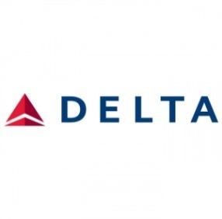












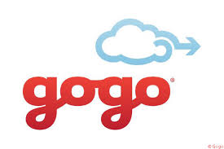
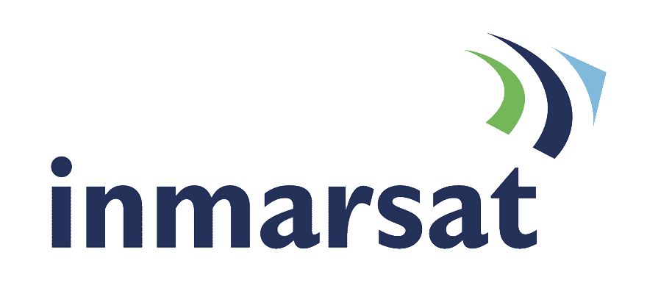

Stay Connected Wherever You Are
Improve
productivity
20+ leading airlines, 3,000+ planes
Our inflight providers:
Notes:
North America Domestic Inflight: 2,900 commercial aircraft equipped with Gogo inflight Wi-Fi
International Inflight: 300+ planes supplied by Panasonic Avionics Corporation
United Airlines (Full fleet coming soon)

Slide 10




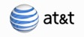





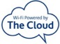


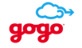


Stay Connected Wherever You Are
Improve
productivity
160+ of the world’s best networks
Asia / Pacific
Europe
North America
Middle East / Africa
Notes:
iPass partners include the world’s largest networks, such as ATT in North America, Deutsche Telecom in Europe and NTT Docomo in Asia. iPass customers get access to more than 160 of the world’s best networks.

Slide 11
Maximize Efficiency
Improve
productivity
iPass makes it easy for end users and IT
No need to look for a free hotspot
No need to enter personal information in order to connect
No need to submit expenses for connectivity
Easy access with single sign-on
Easy deployment with one-click activation
Easy credential management with one-time password
Easy subscriber management with cloud-based administration
No need for extra IT resources
END USERS
IT
Notes:
iPass makes is easy for end users and IT
For end users:
No need to look for a free hotspot
No need to enter personal information in order to connect
No need to submit expenses for connectivity
Easy access with single sign-on
For IT:
Easy deployment with one-click activation
Easy credential management with one-time password
Easy subscriber management with cloud-based administration
No need for extra IT resources

Slide 12


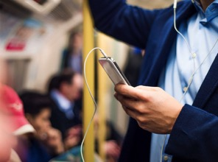
Ensure Privacy and Security
Secure your connections
Secure authentication and identity protection
Keeps credentials secure with SSL encryption
Supports the use of corporate VPNs
Notes:
iPass helps you ensure privacy and security:
We offer Secure authentication and identity protection
SSL encryptions means that during authentication, when credentials are passed from the device to the network, that exchange is protected by the same security that banks use
We support the use of corporate VPNs.

Slide 13
Simple Pricing
Keep costs
predictable
One flat fee per user, per month—no surprises
Price per user drops as the number of committed user licenses grows
Centralized billing gives visibility into mobile connectivity costs
Price per seat
Number of licenses
Notes:
We make pricing simple.
We have one flat, fee per user per month. The costs are predictable – no surprises.
Price per user drops as the number of committed user licenses grows
Centralized billing gives visibility into mobile connectivity costs

Slide 14
iPass SmartConnect Platform
Notes:
iPass is committed to delivering unlimited connectivity, everywhere and invisibly. In order to meet this commitment we have developed and launched our patented iPass SmartConnect platform.
With iPass SmartConnect, we are building the first ever real-time global Wi-Fi hotspot map. The “big data” included in this global map is extremely valuable, as we now know unequivocally where hotspots are, how they perform, where they are connected, how devices are using them, and the possibilities are to improve their performance. And we are only just beginning to tap the boundless value of this data.

Slide 15
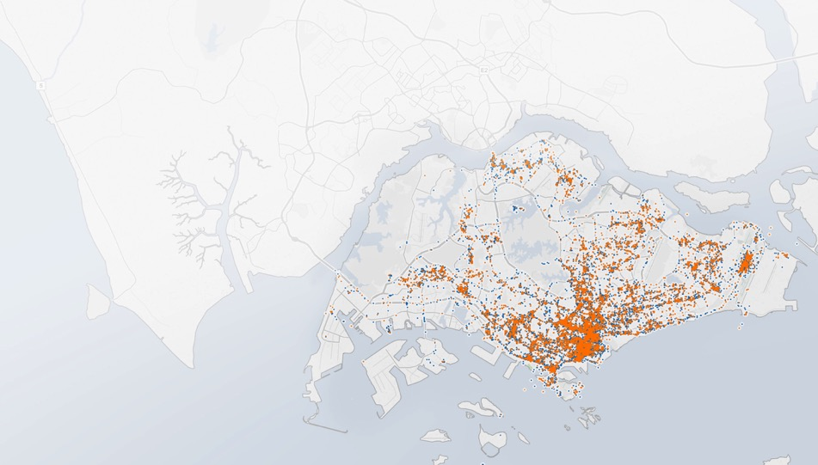
Hotspot Discovery and Curation
Grows the network faster and smarter
Organically curates open hotspots into the network as users roam
Identifies networks iPass can add through network agreement
Takes growth to where users are
Singapore
LEGEND:
Discovered hotspots
iPass hotspots
Notes:
We are constantly working to grow our network. iPass SmartConnect enables us to grow our network faster and smarter.
iPass SmartConnect discovers, catalogues and curates new hotspots, thereby continually improving our coverage through intelligent analysis of where our users try to connect.
iPass SmartConnect identifies hotspots both in and outside the iPass network as iPass users roam.
Here you are looking at a map of Singapore. On the map are iPass hotspots in orange, and in blue are hotspots that we’ve discovered outside of our network, based on where our users are roaming. Now that we can see the hotspots outside of our network, we can organically curate the good, open hotspots. And for the remainder, we can identify the network providers and add the hotspots through a network agreements.
With iPass SmartConnect, we can take growth to where our users are.

Slide 16
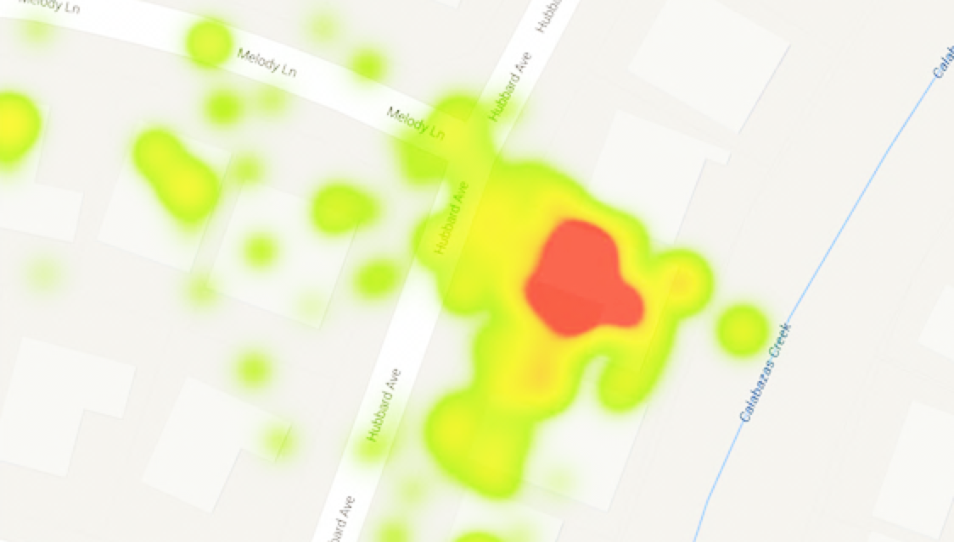
Veri-Fi™
Enables partners to optimize network performance and cost
Rates hotspot performance based on criteria such as signal strength, speed, bandwidth availability, and connection success rate
Can see performance throughout a venue
Notes:
Once we have discovered and catalogued hotspots, we can rate hotspot performance based on criteria such as signal strength, speed, bandwidth availability, and connection success rate
We can see performance throughout a venue.
Use cases:
Partners can optimize network performance
Hotel wants to monitor the quality of the network in different parts of the building to ensure user experience.
BT: they want to offload cellular traffic to Wi-Fi to reduce costs; to do that, they need to understand the network characteristics of the Wi-Fi network

Slide 17

Connection Intelligence
Creates the most seamless Wi-Fi roaming experience
Building a global quality of service (QoS) database for Wi-Fi networks
Continuously improves its knowledge of hotspots through machine learning
Auto-connects devices to the best available hotspot based on QoS history and user needs
Notes:
iPass SmartConnect provides our customers a “best” connectivity experience, accessing securely the highest quality, best performing Wi-Fi hot spot that is available.
Creates the most seamless Wi-Fi roaming experience available.
And improves connection success.
Building a global quality of service (QoS) database for Wi-Fi networks
Continuously improves its knowledge of hotspots through machine learning
Auto-connects devices to the best available hotspot based on QoS history and user needs

Slide 18



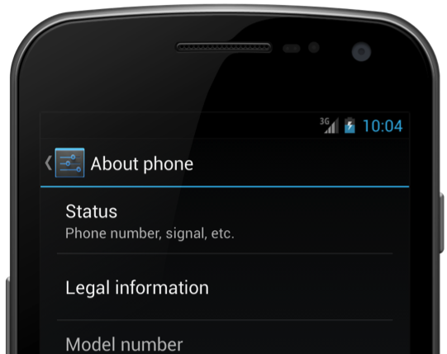
Connection Intelligence
Data shows this cellular signal performs, but the relative cost is high.
Hotspot has provided a poor experience over time. It is removed from the network.
Hotspot offers best user experience based on usage needs, automatically connecting the user.
Notes:
Let’s look at what the user experience is. Particularly when you are in metropolitan areas, you are likely to have multiple choices for connectivity.
iPass identifies underperforming hotspots and removes them from the network.
iPass SmartConnect has a self-learning algorithm that constantly updates its knowledge of hotspot performance. You might have the option to connect to hotspot that is regularly a good performer, but is congested today. iPass SmartConnect decides to pass on that network.
iPass finds the hotspot that will provide the best user experience based on usage needs and automatically connect you.

Slide 19

Free Wi-Fi Isn’t Free
Risks man-in-the-middle attacks, identity spoofing, spying, and tracking by ISPs
Takes time and effort to find
Can introduce inconveniences such as pop-ups, spam, session time-outs and slow speeds from congested networks
Notes:
iPass SmartConnect also delivers added security, because free Wi-Fi is anything but free.
Research states that probably everyone with a portable device has once been connected to a public Wi-Fi network: while having a coffee, on the train, or at a hotel.
An estimated 37.3 million users worldwide and 4.5 million Americans were the victim of phishing—or pharming—attempts, meaning payment details were stolen from hacked computers, smartphones, or website users. Report after report shows that digital identity fraud is an increasingly common problem. Hackers and cyber-criminals currently have many different tricks at their disposal. But the prevalence of open, unprotected Wi-Fi networks makes life extremely easy for them.
In addition, free Wi-Fi takes time and effort to find, and can introduce inconveniences of pop-ups, spam, session time-outs and slow speeds.

Slide 20


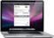

Added Security With Last Mile VPN
Protects your data where it is most vulnerable
Corporate VPN
Internet
Hacker
Hacker
User
Hotspot
iPass VPN Server
Enterprise Applications
Last Mile
“We took a hacker to a café and, in 20 minutes, he knew where everyone else was born, what schools they attended, and the last five things they googled.”
—Maurits Marijn, via Medium
Notes:
We deliver our iPass SmartConnect security capability through last mile VPN. When a connection request is initiated from the device, an encrypted and secure tunnel is created so that the data that is transferred from the Internet to the device is protected. Without it, you are vulnerable to privacy and data theft, as well as software virus and malware infection. iPass eliminates these risks.
If you have a corporate VPN, we encourage you to use it, as it secures the connection end to end. Last Mile refers to the distance between the user’s device and an iPass VPN server; this is where the user is most vulnerable. (A survey we did of 500 CIOs and IT decisions makers from the US, UK, Germany and France shows that only 26% of people surveyed are 100% confident that users are using a VPN every time they go online.)
The Netherlands National Cyber Security Center, a division of the Ministry of Security and Justice, did not issue the following advice in vain: “It is not advisable to use open Wi-Fi networks in public places. If these networks are used, work or financial related activities should better be avoided.” iPass elminates these risks.
From Medium.com: “We took a hacker to a café and, in 20 minutes, he knew where everyone else was born, what schools they attended, and the last five things they googled.”

Slide 21
The Mobile Experience: Without iPass
Airport Wi-Fi
Inflight Wi-Fi
Free Wi-FI
Around Town
Roaming
Multiple
devices
Requires watching ads, giving personal info, or paying after 30 minutes
Requires credit card, which is stuck in the overhead bin until 36k feet
Takes effort to find, is often slow, and introduces security risks
Must search through network IDs to find an available network
Incurs cellular roaming fees and/or foreign language Wi-Fi login screens
3G/4G limits the options for use of multiple devices
Notes:
Let’s look at a day in the life of a mobile worker.

Slide 22
The Mobile Experience: With iPass
Airport Wi-Fi
Inflight Wi-Fi
Free Wi-FI
Around Town
Roaming
Multiple
devices
Requires watching ads, giving personal info, or paying after 30 minutes
Requires credit card, which is stuck in the overhead bin until 36k feet
Takes effort to find, is often slow, and introduces security risks
Must search through network IDs to find an available network
Incurs cellular roaming fees and/or foreign language Wi-Fi login screens
3G/4G limits the options for use of multiple devices
Gate to gate connectivity with a consistent user experience
Ability to connect without a credit card starting at 10k feet
Access high quality networks securely with Last Mile VPN
Seamlessly connect to the best hotspot for your needs
No need to pay for premium services or decipher foreign language pages
Stay connected regardless of your device or mobile plan
Notes:
With iPass, you can overcome these inconveniences, reducing friction and increasing productivity.

Slide 23
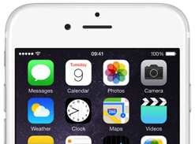
Use Our App, or Put Our Capabilities in Yours
New Software Development Kit integrates iPass connectivity into your platform
Access to iPass API’s supporting intelligent connection, authentication, provisioning
Supported Platforms: iOS and Android
Insert client logo
Notes:
We recognize that there are endless initiatives that could benefit from access to our capabilities. The iPass SmartConnect Software Development kit (SDK) provides the tools to build adaptive network selection applications for smartphones, tablets, and laptops. Developers can access iPass core technologies to activate, authenticate, connect, and create custom interfaces for presenting and selecting Wi-Fi networks.
Applications built using the iPass SDK have instant and secure access to any of the iPass more than 57 million hotspots. The SDK is designed for enterprises, operators and solution vendors seeking to leverage iPass wireless connectivity technology in their applications.
Through our SDK, iPass will build a developer community and deliver value to the endless number of devices, applications and services that could benefit from our patented innovations.
Note that the connectivity is built into an application, but it is the device that is allowed access to the Internet. It is not possible to provide granular access to individual applications.

Slide 24




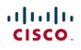






Trusted by Hundreds of Customers
“We needed a global Wi-Fi solution that was easy to use and just worked—iPass works.”
—Guy Schofield, IT Delivery Manager, Ericsson
“iPass is the only internet provider that can match 3M’s global foot print of users.”
—Charles A. Metzroth, Network Security Global Product, 3M
“iPass is the only global Wi-Fi solution on the market that addresses our needs of simplicity and security for our users.”
—Sean Kelly, Technical Manager, Emirates

Slide 25
The Global Mobile Connectivity Leader
Unlimited, Everywhere, Invisible connectivity, powered by the world’s largest Wi-Fi network
SaaS subscription model as a secure, cloud-based service
iPass SmartConnect creates best Wi-Fi roaming experience
Global operations, Silicon Valley headquarters
On Nasdaq since 2003
40+ patents
62M+
HOTSPOTS
180+
COUNTRIES
AND
TERRITORIES
160+
NETWORKS
Notes:
iPass is the leading provider of global mobile connectivity. We offer unlimited, everywhere invisible connectivity, powered by the world’s largest Wi-Fi network.
SaaS subscription model as a secure, cloud-based service
Global operations, Silicon Valley headquarters
the NEW iPass is strong and getting stronger
We have $20M in cash, no debt
New management and a new team
61+ million hotspots in more than 120 countries
160+ networks
5+ million devices

Slide 26
Addendum

Slide 27
Objection Handling
We use tethering: There are many issues with tethering.
Limited data
Data and voice
Battery consumption
Single point of failure
Most cellular data plans are not unlimited and if they are, they are throttled after a certain threshold, depending on the carrier. Bandwidth intensive work is better done over a hotspot to maintain good connectivity and avoid running out of phone data.
Certain carriers do not support simultaneous usage of voice and data. iPass supports using voice and data simultaneously.
Tethering reduces the available phone battery. Using iPass means a user does not have to drain the battery just to stay connected.
Tethering makes the phone a single point of failure for your connectivity. Having access to hotspots along with a cell phone diversifies your connectivity options.
Bandwidth
Security
Cost
Limited network access
With tethering, the more devices one connects, the worse the connectivity, as they are all constrained by how much data tethering can transport. iPass connects multiple devices at the same time without any degradation of quality.
Tethering connections between a cell phone and other devices are unsecured, and the last mile is where most attacks occur. With the iPass last mile VPN, iPass provides security where the risk is greatest.
Data charges from tethering tend to be prohibitively expensive when traveling internationally. iPass provides unlimited access to a global network for a predictable monthly price.
With tethering, users are limited to the network of their cell phone provider. iPass aggregates more than 160 networks. Moreover, with iPass SmartConnect, iPass is able to choose the best network in any location and provide the best user experience.

Slide 28
Objection Handling (cont’d)
We can just use unlimited cellular data plans:
Cellular is not ideal for all data consumption. Moreover, Wi-Fi provides a better experience for streaming and high-bandwidth applications. Wi-Fi is also available in some places where cellular is not, most importantly inflight, as well as on all devices, while cellular is not. Your smartphone users are already choosing Wi-Fi more than 50 percent of the time. If your team travels internationally, your costs will be higher due to roaming charges.

Slide 29
Objection Handling (cont’d)
We use 3G/4G for data:
We use Mifi:
If your team uses cloud-based applications, accesses or shares large files, or streams video, you need Wi-Fi access. Using 3G/4G in these use cases will likely incur data overages and increase your costs. If your team travels internationally, your costs will also be higher due to roaming charges. Moreover, if your team uses cloud-based apps, they will perform better on Wi-Fi networks, because Wi-Fi is typically faster than 3G/4G.
Mifi devices can be significantly more expensive than iPass, because they are subject to the data overages and roaming charges of cellular. Mifi devices also require you to carry an extra device. Mifi devices allow others to share your network, which can sacrifice speed, reliability, and security. Moreover, if your team uses cloud-based apps, they will perform better with iPass, because Wi-Fi is typically faster than 3G/4G.

Slide 30

The Total Economic Impact™ of iPass
Business benefits and cost savings enabled by iPass
*An independent study conducted by Forrester Consulting and commissioned by iPass

Slide 31

Multinational Corporation Achieves 486% ROI
Receives $14.8M in total benefits by:
Improving employee productivity
Avoiding alternate connectivity costs, especially in-flight
Sees immediate payback (<1 month)
Regains 118,800 productive worker hours (per year)
Notes:
Technology leadership: Inflight, Hotspot 2.0, 802.1 (?)

Slide 32

Why the Customer Selected iPass
Global Wi-Fi footprint
Competitive cost for inflight Wi-Fi
Centralized billing
Last Mile VPN complementary to existing security
“The main benefit, if you sum it up, is the ease of connectivity that iPass affords our employees. It means that they can stay connected to our company and stay productive.”
–Global product lead for network security
Notes:
Technology leadership: Inflight, Hotspot 2.0, 802.1 (?)

